Slide 2
Encouraging and Guiding Students to Utilize Databases
Claremont Data Science Conference
August 28, 2019
Greg Reardon
School of Pharmacy and Health Sciences
Keck Graduate Institute
greardon@kgi.edu

Slide 3
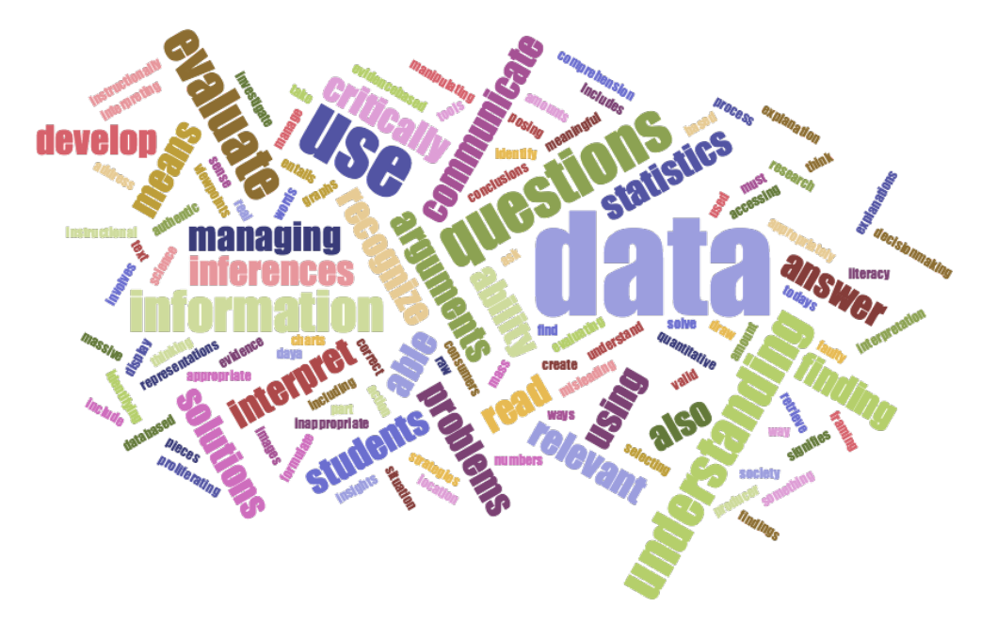
Data Literacy
Ability to collect, manage, evaluate, and apply data, in a critical manner
Ability to extract value out of data
Currently, data literacy education is inconsistent across public, private and academic sectors
  http://dataliteracy.ca/wp-content/uploads/2016/04/Strategies-and-Best-Practices-for-Data-Literacy-Education.pdf
Notes:
Post-secondary curricula already introduce students to new theories and practices, and to new forms of literacy such as information literacy and computational thinking.

Slide 4
National Academies of Science, Engineering and Medicine: Data Science for Undergraduates
Time to act is now. It is essential that academic institutions and other stakeholders take steps to prepare students for a data-enabled world.
Academic institutions should encourage the development of a basic understanding of data science in all undergraduates.
Academic institutions should embrace data science as a vital new field that requires majors and minors in data science as well as the development of capable faculty.
https://www.nap.edu/catalog/25104/data-science-for-undergraduates-opportunities-and-options

Slide 5
National Academies of Science, Engineering and Medicine: Data Science for Undergraduates
Academic institutions should ensure that ethics is woven into the data science curriculum from the beginning and throughout.
Academic institutions should be prepared to evolve programs over time, creating flexibility and incentives for sharing of courses, materials, and faculty among departments and programs.
Academic institutions should ensure that programs are continuously evaluated and should work together to develop professional approaches to evaluation.
https://www.nap.edu/catalog/25104/data-science-for-undergraduates-opportunities-and-options

Slide 6
Data Literacy Competencies Matrix
Key Ability/Knowledge Area
Conceptual Framework
Data Collection
Data Management
Data Evaluation
Data Application
http://dataliteracy.ca/wp-content/uploads/2016/04/Strategies-and-Best-Practices-for-Data-Literacy-Education.pdf

Slide 7
Data Literacy Competencies Matrix
Key Ability/Knowledge Area
Conceptual Framework
Data Collection
Data Management
Data Evaluation
Data Application
Conceptual Competency
Introduction to Data
http://dataliteracy.ca/wp-content/uploads/2016/04/Strategies-and-Best-Practices-for-Data-Literacy-Education.pdf

Slide 8
Data Literacy Competencies Matrix
Core Competencies
Data Discovery and Collection
Evaluating and Ensuring Quality of Data and Sources
Key Ability/Knowledge Area
Conceptual Framework
Data Collection
Data Management
Data Evaluation
Data Application
http://dataliteracy.ca/wp-content/uploads/2016/04/Strategies-and-Best-Practices-for-Data-Literacy-Education.pdf

Slide 9
Data Literacy Competencies Matrix
Core Competencies
Data Organization
Data Manipulation
Key Ability/Knowledge Area
Conceptual Framework
Data Collection
Data Management
Data Evaluation
Data Application
Advanced Competencies
Data Conversion (from format to format)
Metadata Creation and Use
Data Curation, Security and Re-Use
Data Preservation
http://dataliteracy.ca/wp-content/uploads/2016/04/Strategies-and-Best-Practices-for-Data-Literacy-Education.pdf

Slide 10
Data Literacy Competencies Matrix
Core Competencies
Data Tools
Key Ability/Knowledge Area
Conceptual Framework
Data Collection
Data Management
Data Evaluation
Data Application
Core Competencies
Basic Data Analysis
Data Interpretation (Understanding Data)
Identifying Problems Using Data
Data Visualization
Presenting Data (Verbally)
Data Driven Decisions Making (based on the data)
http://dataliteracy.ca/wp-content/uploads/2016/04/Strategies-and-Best-Practices-for-Data-Literacy-Education.pdf

Slide 11
Data Literacy Competencies Matrix
Conceptual Competencies
Critical Thinking
Data Culture
Data Ethics
Key Ability/Knowledge Area
Conceptual Framework
Data Collection
Data Management
Data Evaluation
Data Application
Core Competencies
Data Citation
Data Sharing
Advanced Competency
Evaluating Decisions Based on Data
http://dataliteracy.ca/wp-content/uploads/2016/04/Strategies-and-Best-Practices-for-Data-Literacy-Education.pdf

Slide 12
Student Engagement
Projects should include real-world data
  Relevant to students‘ interests, in an engaging context
  More likely to become lifelong learners if students engage in inquiry that interests or impacts them
  Working with data can foster innovation and improve learning
Projects should offer students opportunities to challenge and stretch themselves
Should offer learning environments and experiences that lead to measurable outcomes

Slide 13
Student Engagement
Teamwork should be considered, but is not required
Instructors must be engaged themselves, before they can help engage students
Project-based learning is preferred over traditional content delivery
Should welcome and include all students, regardless of their identity-related characteristics or educational background and attainment

Slide 14



Slide 15
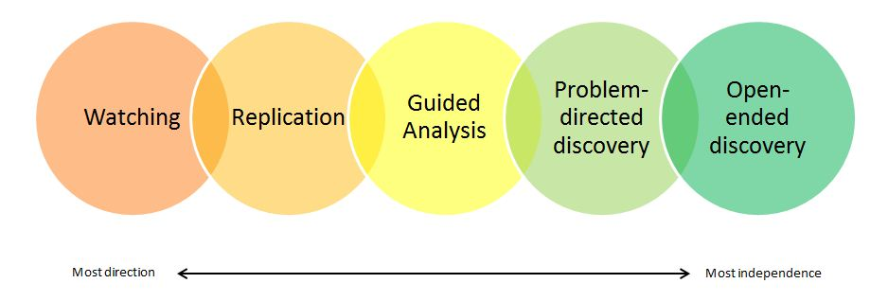
Engaging Students with Data
https://serc.carleton.edu/sp/library/twd/modes_engagement.html

Slide 16

Barriers and Challenges
General misconception that millennials have inherent technological skills and abilities
  In reality, there is a complex and diverse range of skills in these students, which requires formal education to bridge the gaps
  This misconception has resulted in a major skills gap in industry, and the daunting realization that this must be remedied.
http://dataliteracy.ca/wp-content/uploads/2016/04/Strategies-and-Best-Practices-for-Data-Literacy-Education.pdf

Slide 17
Barriers and Challenges
Data scientists are often characterized as “end user programmers,” meaning they see programming as a means to an end rather than a pursuit that is inherently interesting.
Must teach an entire workflow rather than simply any individual library or method. Students learn how to properly collect data, how to import and manipulate data in their computing environment, and how to make sense of data.
Students in data science classrooms have widely varying backgrounds. Data science is often their first introduction to programming.
https://seankross.com/2019/01/08/The-Front-Lines-of-Teaching-Data-Science.html

Slide 18
Barriers and Challenges
Instructors should make sure that their data science students are well versed in presenting analytically results and in writing essays that explain reasoning and conclusions.
Preparing a data science course is aggravated by how difficult it is to find relevant, domain-specific datasets.
Instructors face a huge amount of uncertainty and teach their students how to cope with uncertainty.
  Instructors actively normalize the experience of “not knowing everything” by showing students how to search online for the answers to student questions.
https://seankross.com/2019/01/08/The-Front-Lines-of-Teaching-Data-Science.html

Slide 19
Student Search for Meaning
Data literacy connects knowledge with power.
Knowledge of how to deal with data may be one of the most powerful weapons that professionals, and everyone, can have. (Littlejohn Shinder)
Data is to be open and useable to everyone, and thus “works to empower civil society organizations, journalists and citizens with the skills they need to use data effectively in their efforts to create more equitable and effective societies.”
(School of Data)

Slide 20
Jobs Are Meaningful Too
"When you can demonstrate the ability to analyze data and make informed recommendations to your employer, you become an indispensable part of your team no matter what type of work you're doing.“ (Mirjana Schultzat)

Slide 21
Jobs Are Meaningful Too
Report from Business-Education Forum
  Employers are struggling to hire workers who understand data science.
    Fluency in data science and analytics is among the nation’s most yawning of skills gaps
    An estimated 2.72 million new job postings in 2020 will seek workers with skills in data science and analytics.
  Gallup Poll
    69 percent of employers expect candidates with data science skills will get preference for jobs
    But just 23 percent of college leaders said their graduates will have those skills.
https://www.insidehighered.com/news/2017/03/30/report-urges-data-science-course-work-all-undergraduates-close-growing-skills-gap
Notes:
This requires fixes by both higher education and businesses.

Slide 22
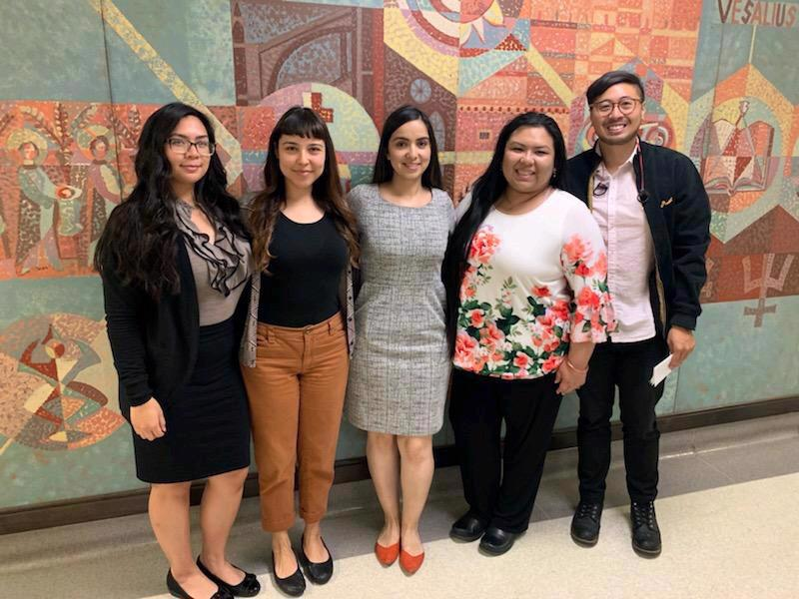
Research Club
“RC is a KGI student club where individuals who are passionate about research may learn, gather, and share information.”
https://kgi.campuslabs.com/engage/organization/researchclub

Slide 23
Research Club
Hosts educational events and meetings to discuss current research opportunities.
Connects selected members of the organization with research opportunities that are provided within KGI.
A contract is signed by both student and faculty to ensure mutual commitment before starting research projects.
Notes:
The contract will specify logistical information (number of hours, student responsibilities and expectation, etc.) in order provide effective and thorough communication for all those involved.

Slide 24
Student Research Projects
California Health Interview Survey - Unmet health needs of pediatric asthmatics in California
Using data from the Icahn School of Medicine Asthma Health App to identify leverage points for improving asthma self-management
Medical Expenditure Panel Survey - Underuse of statins in patients at risk for atherosclerotic heart disease events

Slide 25
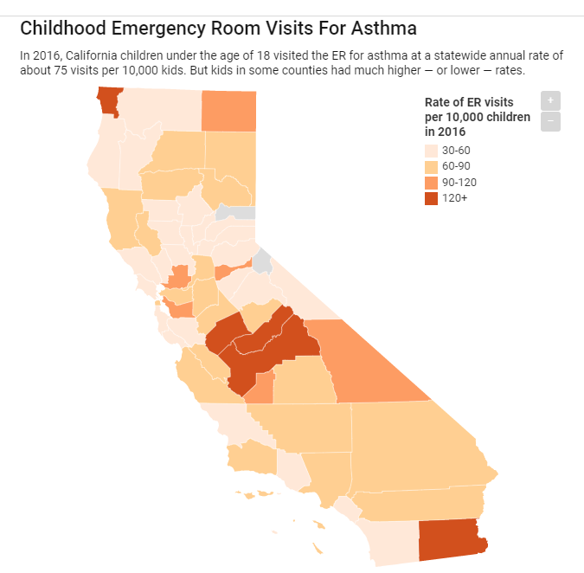
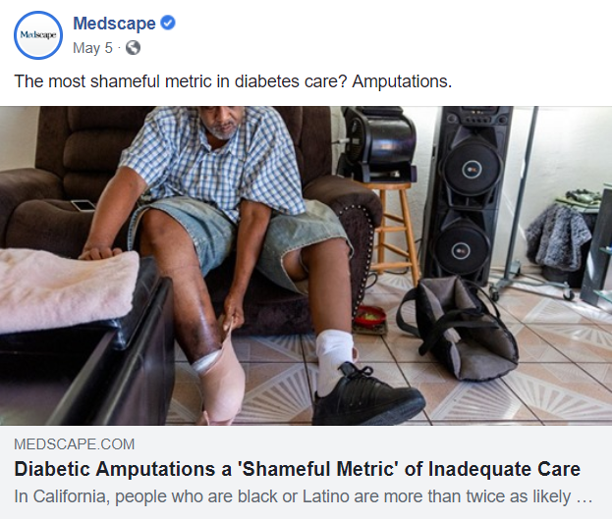
California Health Interview Survey
Unmet needs of pediatric asthmatics in CA
https://californiahealthline.org/news/dirty-air-and-disasters-sending-kids-to-the-er-for-asthma/

Slide 26
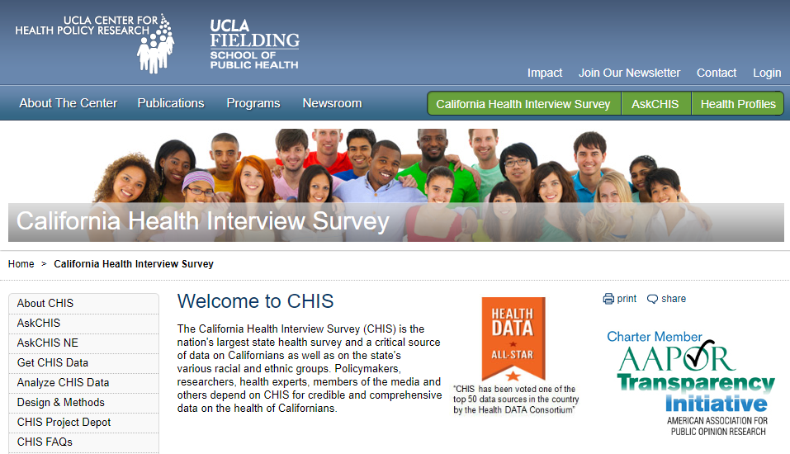
California Health Interview Survey
Unmet needs of pediatric asthmatics in CA
http://healthpolicy.ucla.edu/chis/Pages/default.aspx/

Slide 27

KGI Hosts 4th Annual Shark Tank App Competition

Slide 28
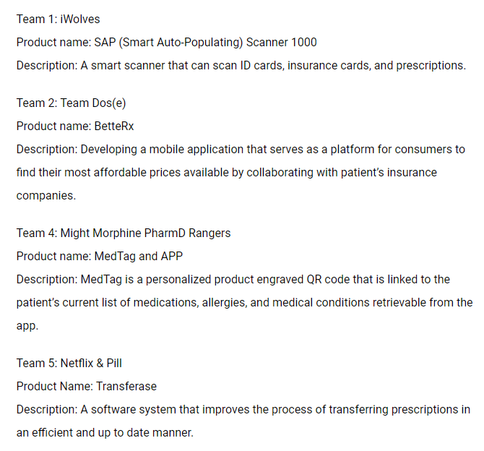
Shark
Tank
Apps
2018

Slide 29
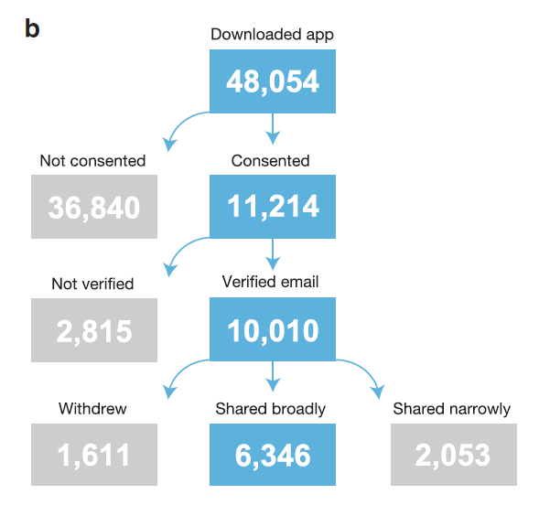
Icahn Asthma Health App
Icahn School of Medicine Asthma Health App built using Apple's ResearchKit framework

Slide 30
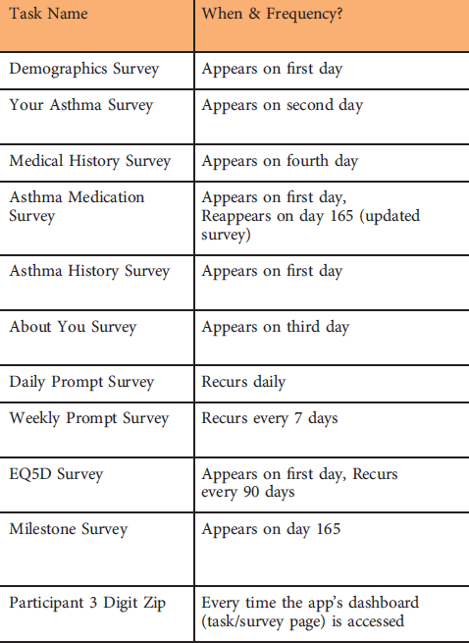
Icahn Asthma Health App
https://www.synapse.org/#!Synapse:syn8361748/wiki/415363

Slide 31
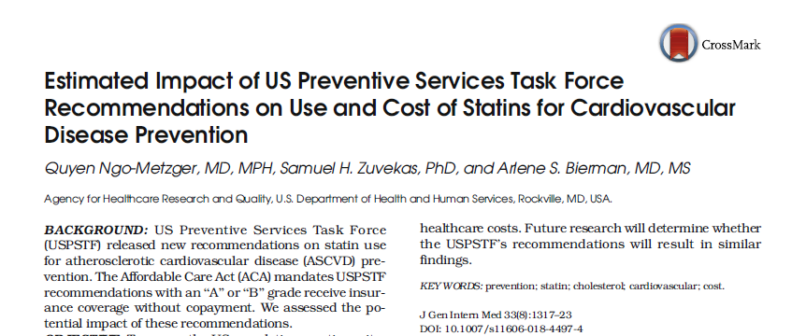
Medical Expenditure Panel Survey

Slide 32
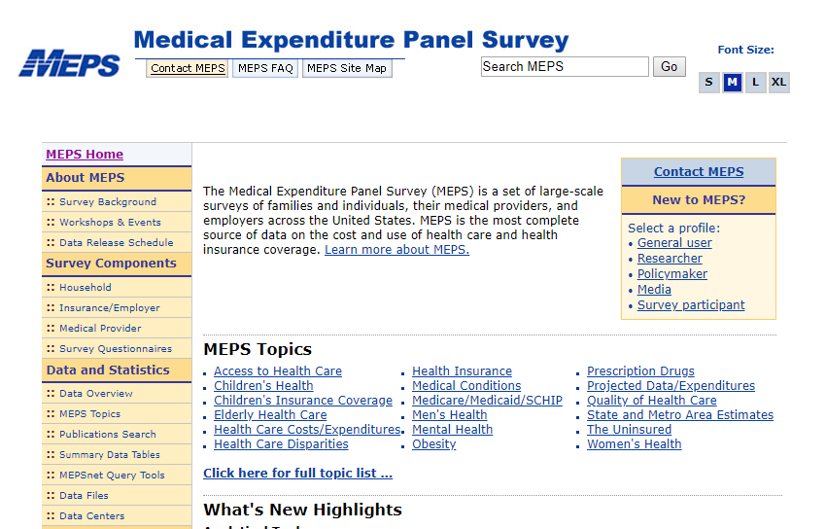
Medical Expenditure Panel Survey
https://www.meps.ahrq.gov/mepsweb/

Slide 33

Earlier Benzodiazepine Project

Slide 34
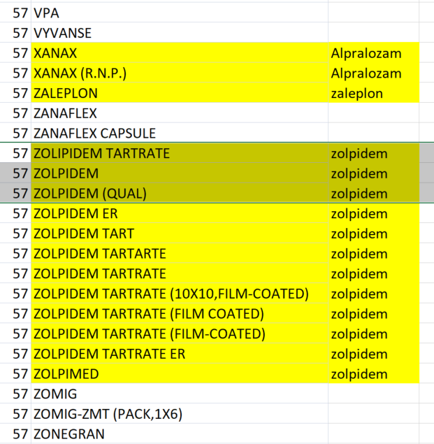
Recoding

Slide 35
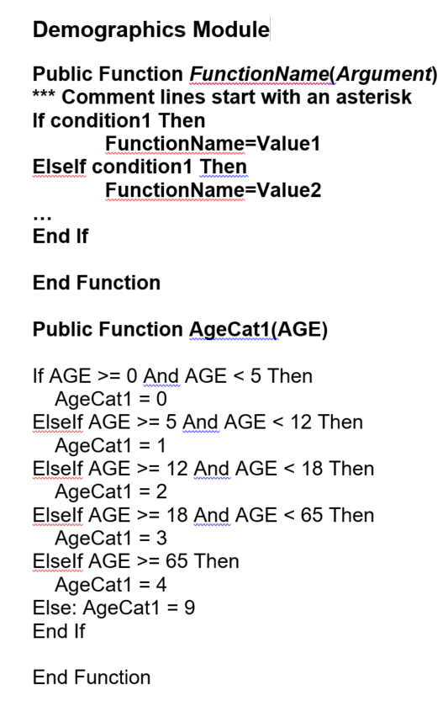
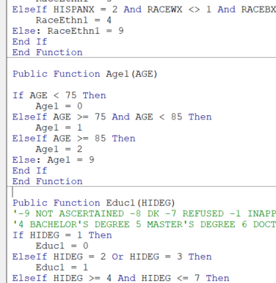
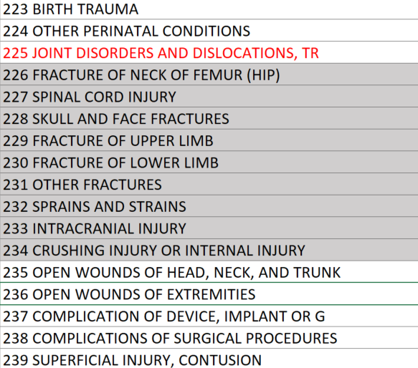
Recoding

Slide 36

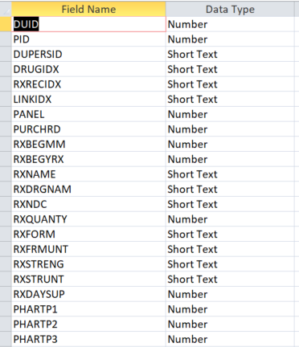
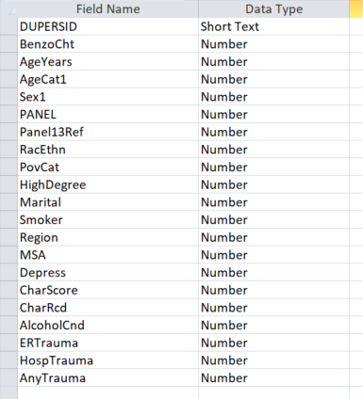
Statistical Analytical File

Slide 37
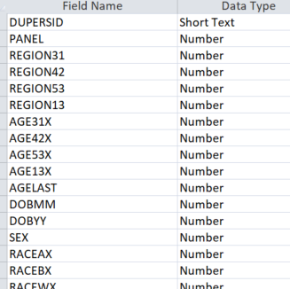
Statistical Analytical File

Slide 38
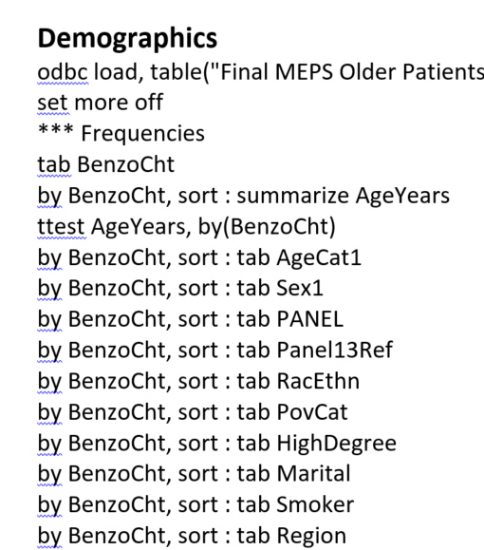
Statistical Programming

Slide 39
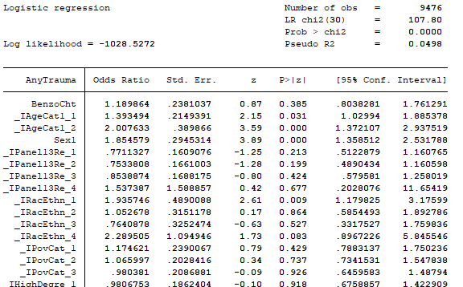
Analysis

Slide 40

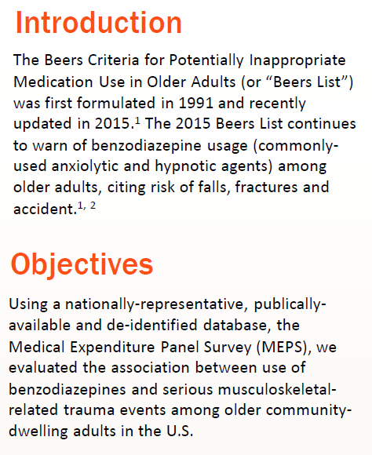
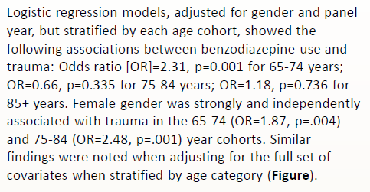
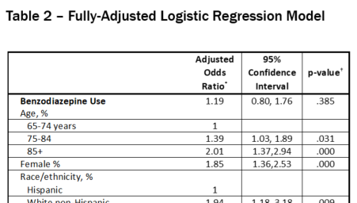
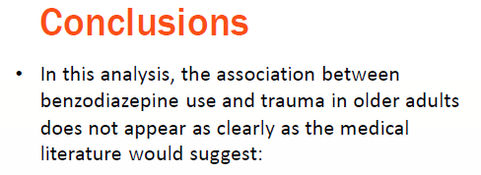
Presentation
Association Between Benzodiazepine Use and Trauma in Older Patients:
Findings from the Medical Expenditure Panel Survey
Brandon Matacic, Kiki Kapolis, Gregory Reardon, M. Chandra Sekar

